Slide 1
Regular Expressions

Slide 2
Regular Expressions
A sequence of characters that forms a search pattern. Some of their uses:
pattern matching
string matching
“find-and-replace”
do something with matched pattern
validate data
parse data
etc.
Typically made up from special characters called “metacharacters”
Notes:
Today we will talk about regular expressions. Regex is something that you will be using a lot, especially when you want to extract specific information from a text file. For example, in cases that you want to extract all the email accounts that appear in a text file, or all the urls, etc.
Pattern matching: for example when you want to find all the words in a file
String matching: the exact string: e.g. the word “data”
Validate data: e.g.: want to validate a date format

Slide 3
Regular Expressions (Regex)
Regex is one of the things you should learn from this class!

Slide 4
Grammar of Regex
regex = one or more non-empty branches separated by ‘|’
branch = one or more pieces
piece = atom followed by quantifier
quantifier = *, +, ?or bound
bound = atom{n}, atom{n,}, atom{m,n}
atom = (regex) or () or ‘^,$’ or \ followed by ‘^.[$()|*+?{\’ or any character or bracket expression
bracket-expression = a list of characters enclosed in brackets ‘[]’

Slide 5
Atoms
Atom
Single character
Dot
Class
(or “bracket expression”)
Anchor
Notes:
sincgle character might be a letter, a symbol or a digit
dort period
Class can be any character from a pre-defined set of characters

Slide 6
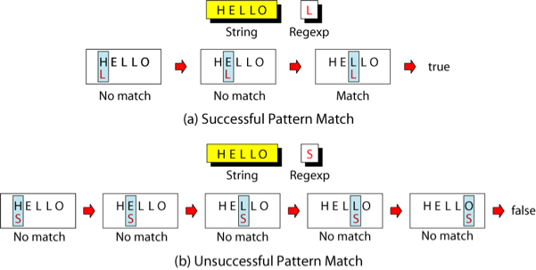
Single-Character
A single character atom matches itself
Notes:
The simplest atom we will use is a single character

Slide 7
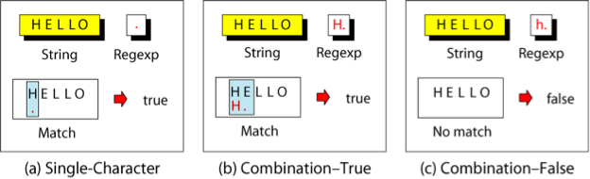
Dot
A dot atom matches any single character except for a new line character (“\n”)
Notes:
Note that \n is the new line character.

Slide 8
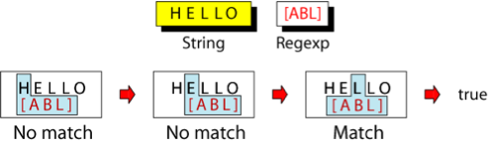
Class / Bracket Expression
A class matches only one single character that can be any of the characters defined in a set (defined by square brackets []).
Example: [ABL] matches either A, B, or L.

Slide 9
More about character classes
Ranges can also be specified in character classes (-)
[1-9] is the same as [123456789]
[a-e] is equivalent to [abcde]
You can also combine multiple ranges
[a-e1-9] is equivalent to [abcde123456789]
You can also specify characters to be excluded from the set using the character (^)
[^0-9] matches any character other than a number.

Slide 10
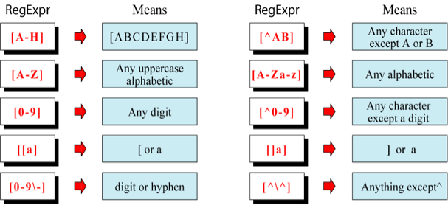
Examples
Note: If you want to use special characters (e.g., -,^) as a literal, you need to escape them with a backslash

Slide 11
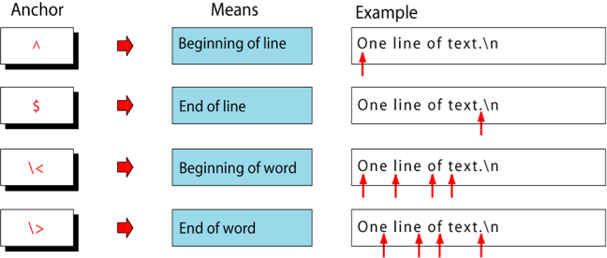
Anchors
An anchor atom specifies the position in the string where a match must occurs

Slide 12
In-class examples
Match all characters
Find all end of lines
Find all digits
Find all characters that are not digits
Find all words
Find every line that starts with a digit

Slide 13
Operators
An operator combines atoms
Operator
Sequence
Alternation
Repetition
Group
|
{m,n}
( )
Notes:
A sequence is a sequence of atoms
Alternation, is represented by a vertical bar and it has the meaning of logical or, for example, either whatever is before the vertical bar, or whatever comes after the vertical bar.
Repitition represented by the brackets, and it matches the character that appears before the bracket from m to n times.
A group, is represented by the parentheses and inside the parentheses can be any regular exrpe

Slide 14
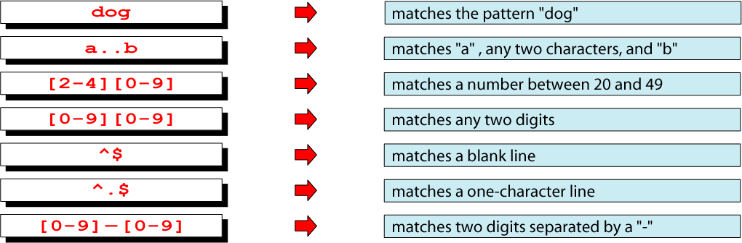
Sequence Operator
A sequence of atoms

Slide 15

Alternation Operator (or): |
An alternation operator is used to define one or more alternatives.

Slide 16
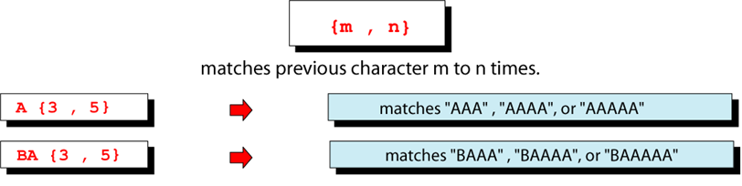
Repetition Operator: {}
A repetition operator specifies that the atom or expression immediately before the repetition may be repeated.

Slide 17
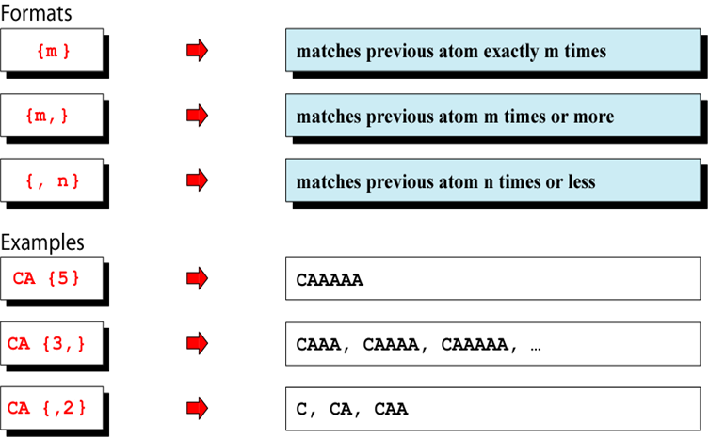
Basic Repetition Forms

Slide 18
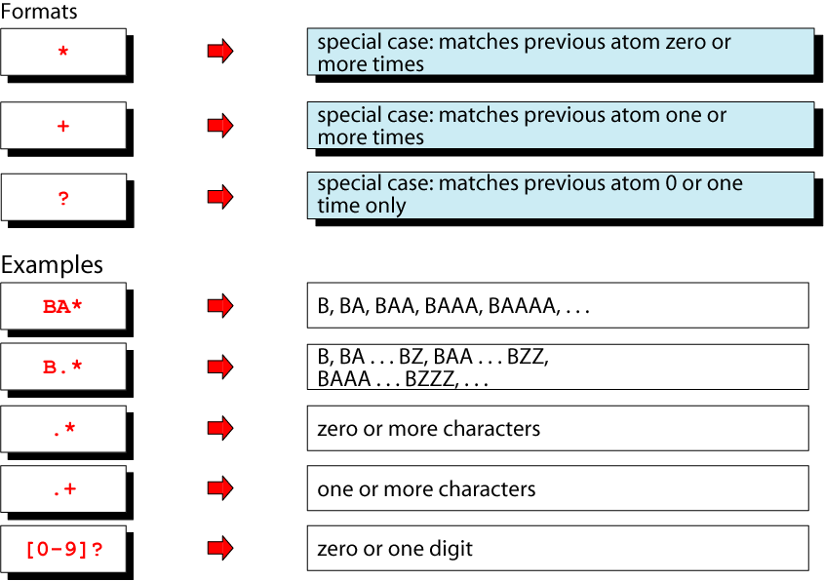
Short Form Repetition Operators

Slide 19
Question: Repetition Operators
Use short form repetition operators to represent the following regular expressions in basic repetition forms?
a{2,}

Slide 20
Question: Repetition Operators
Use short form repetition operators to represent the following regular expressions in basic repetition forms?
a{2,}
Answer: aaa* or aa+

Slide 21
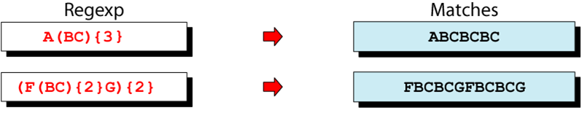
Group Operator
In the group operator, when a group of characters is enclosed in parentheses, the next operator applies to the whole group, not only the previous characters.

Slide 22
Group Operator
What do these regular expressions match?
b (cd)*
h (d)+
j? k+
(cd){2,5}
o(pre){3,}
Panos|Ipeirotis

Slide 23
Grep: Backreference
Sometimes it is handy to be able to refer to a match that was made earlier in a regex
This is done with backreferences
\n is the backreference specifier, where n is a number
Looks for nth subexpression
For example, find if the first word of a line is the same as the last:
1st subexpression
^([a-zA-Z]{1,}) .* \1$
End of line
Beginning
of line
A word
(1st subexpression)
Any Character

Slide 24
Backreference Examples
Find all lines in fields.txt that have a number in the form [0-9]*x[0-9]x[0-9]*, where x is a digit:
grep ‘([0-9])([0-9])\1’ fields.txt
Find all numbers that have two consecutive same digits:
grep ‘([0-9])\1)’ fields.txt

Slide 25
Group Exercise (in class)
Write down the regular expressions for the following:
Dollar amount with optional cents (e.g. $0.33, $784)
Time of Day (e.g. 12:15am, 3:34pm)
HTML headers (<h1> to <h6>, and <H1> to <H6>)
Match urls only of the form http://www.alphanumeric.com)
Match an email of the form username@domain (assume that the domain might be in the form alphanumeric.alphanumeric, or alphanumeric.alphanumeric.alphanumeric)
Find a telephone number (e.g, 212-555-0921)

Slide 26
Matching a float Number (Example)
We want to match a signed float (decimal) number, i.e.,:
+12.34 or -1.457 or 1023.4568 etc.

Slide 27
Matching a float Number (Example)
We want to match a signed float (decimal) number, i.e.,:
+12.34 or -1.457 or 1023.4568 etc.
1st step: we need at most a sign in the beginning : [+-]?

Slide 28
Matching a float Number (Example)
We want to match a signed float (decimal) number, i.e.,:
+12.34 or -1.457 or 1023.4568 etc.
1st step: we need at most a sign in the beginning : [+-]?
2nd step: we need at least one digit: [0-9]+

Slide 29
Matching a float Number (Example)
We want to match a signed float (decimal) number, i.e.,:
+12.34 or -1.457 or 1023.4568 etc.
1st step: we need at most a sign in the beginning : [+-]?
2nd step: we need at least one digit: [0-9]+
3rd step: we need one dot: \.

Slide 30
Matching a float Number (Example)
We want to match a signed float (decimal) number, i.e.,:
+12.34 or -1.457 or 1023.4568 etc.
1st step: we need at most a sign in the beginning : [+-]?
2nd step: we need at least one digit: [0-9]+
3rd step: we need one dot: \.
Final step: we need at least one digit: [0-9]+

Slide 31
Matching a float Number (Example)
We want to match a signed float (decimal) number, i.e.,:
+12.34 or -1.457 or 1023.4568 etc.
1st step: we need at most a sign in the beginning : [+-]?
2nd step: we need at least one digit: [0-9]+
3rd step: we need one dot: \.
Final step: we need at least one digit: [0-9]+
Pattern that matches float numbers: [+-]?[0-9]+\.[0-9]+

Slide 32
Summary of what we learned and more
Meta | Description
. | Matches any single character. With bracket expressions, the dot character matches a literal dot. For example, a.c matches "abc", but [a.c] matches only "a", ".", or "c".
[] | A bracket expression. Matches a single character that is contained within the brackets. For example, [abc] matches "a", "b", or "c". [a-z] specifies a range which matches any lowercase letter from "a" to "z".
[^ ] | Matches a single character that is not contained within the brackets. For example, [^abc] matches any character other than "a", "b", or "c".
^ | Matches the starting position within the string.
$ | Matches the ending position of the string or the position just before a string-ending newline.
( ) | Defines a marked subexpression.
\n | Matches what the nth marked subexpression matched, where n is a digit from 1 to 9.
* | Matches the preceding element zero or more times.
{m,n} | Matches the preceding element at least m and not more than n times.
? | Matches the preceding element zero or one time.
+ | Matches the preceding element one or more times.
| | The alternation operator matches either the expression before or the expression after the operator

Slide 33
Summary of what we learned and more
Python | ASCII | Description
 | [A-Za-z0-9] | Alphanumeric Characters
\w | [A-Za-z0-9_] | Alphanumeric characters plus "_"
\W | [^A-Za-z0-9_] | Non-word characters
 | [A-Za-z] | Alphabetic characters
 | [ \t] | Matches space and tab
\d | [0-9] | Digits
\D | [^0-9] | Non - Digits
 | [a-z] | Lower-case letters
 | [A-Z] | Upper-case letters

